Slide 1
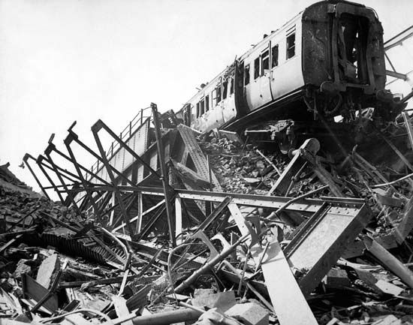
How many people died in the war?
During the Blitz 7,736 children were killed and 7,622 seriously wounded. Many children were orphaned or lost brothers and sisters. As well as being victims of the raids, children were involved in relief efforts.

Slide 2
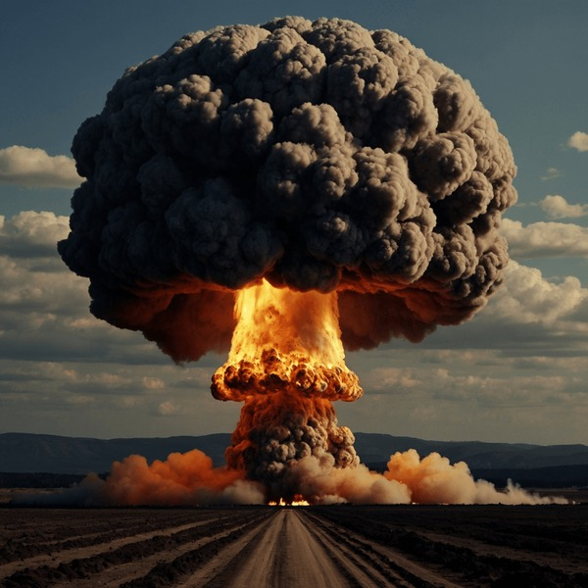
It is estimated that more than 12,000 metric tons of bombs were dropped on London and nearly 30,000 civilians were killed by enemy action.

Slide 3
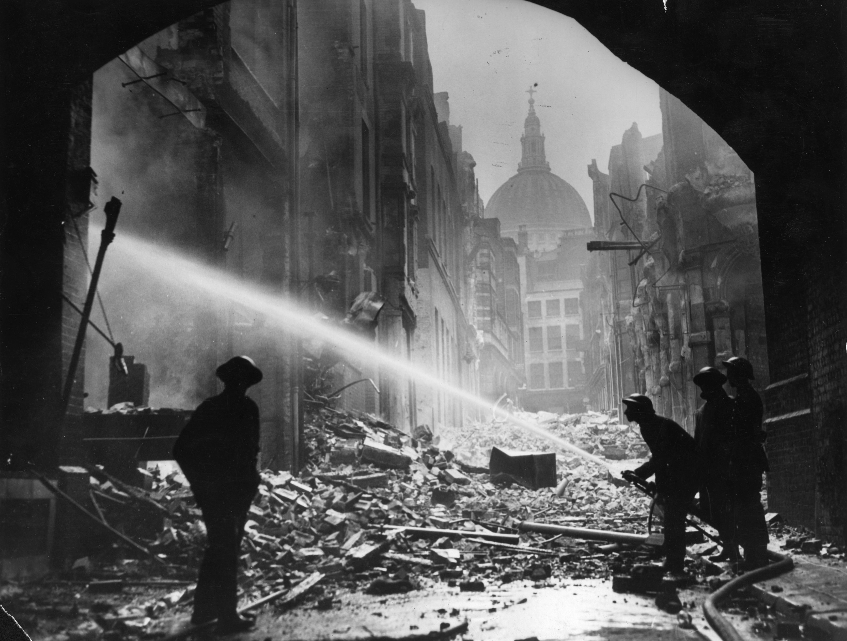
n the eight months of attacks, some 43,000 civilians were killed. This amounted to nearly half of Britain's total civilian deaths for the whole war. One of every six Londoners was made homeless at some point during the Blitz, and at least 1.1 million houses and flats were damaged or destroyed.

Slide 4
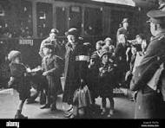
It began on September 7th, 1940, and lasted for eight months. The campaign was carried out by the German air force, the Luftwaffe, and it caused widespread destruction and loss of life. The Blitz was part of Germany's plan to soften up Britain before launching a full-scale invasion.

Slide 5
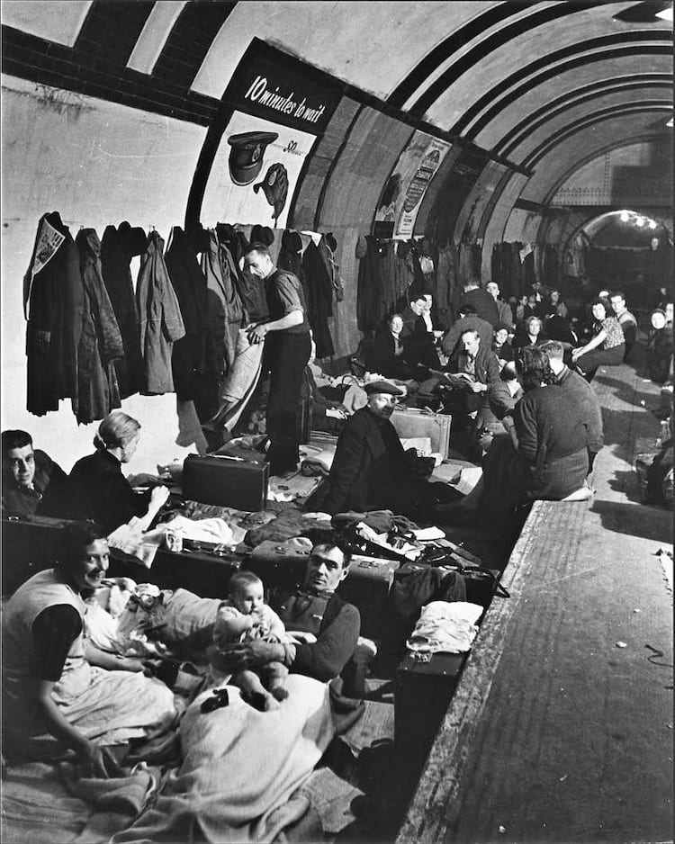
Why did the Blitz fail to reach its objective? The Luftwaffe was not prepared for the task. The Luftwaffe was structured and equipped to provide tactical support to the German army. Its aircraft were relatively short range and lacked the payload to deliver a heavy enough weight of bombs to the targets.

Slide 6

What was the German name for the blitz?
'Blitz' is an abbreviation of the German word 'blitzkrieg', meaning 'lightning war'. Its explosive sound describes the Luftwaffe's almost continual aerial bombardment of the British Isles from September 1940 to May 1941. For eight terrifying months civilians across the country were in mortal danger.

Slide 7
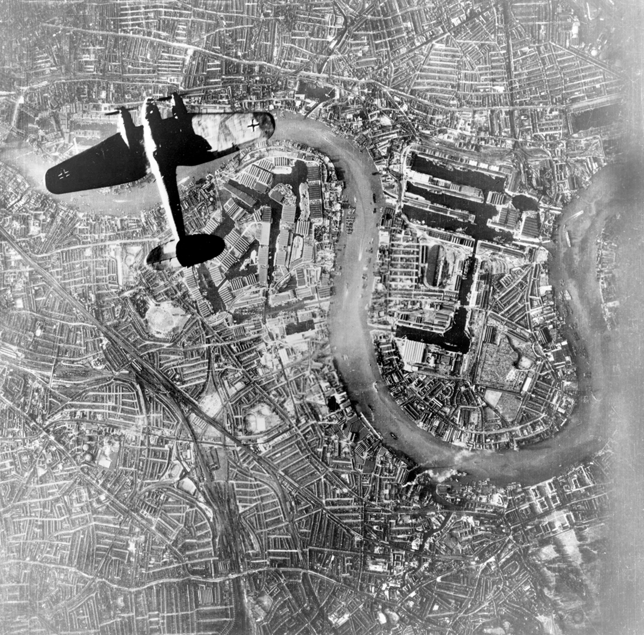
The Blitz began on 7 September, 'Black Saturday', when German bombers attacked London, leaving 430 dead and 1,600 injured. London was then bombed for 57 consecutive nights, and often during daytime too. London experienced regular attacks and on 10-11 May 1941 was hit by its biggest raid.

Slide 8
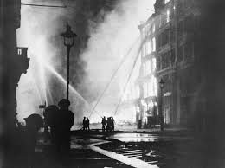
The Blitz began on 7 September, 'Black Saturday', when German bombers attacked London, leaving 430 dead and 1,600 injured. London was then bombed for 57 consecutive nights, and often during daytime too. London experienced regular attacks and on 10-11 May 1941 was hit by its biggest raid.

Slide 9
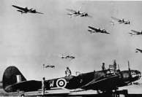
Adolf Hitler and Reichsmarschall Hermann Göring, commander-in-chief of the Luftwaffe, ordered the new policy on 6 September 1940. From 7 September 1940, London was systematically bombed by the Luftwaffe for 56 of the following 57 days and nights.

Slide 10
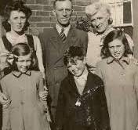
BEFORE
Standards of wartime housing in Britain ranged from dilapidated tenement slums to stately homes. A high proportion of families still had outside lavatories and no bathroom. Children often shared beds with brothers and sisters or parents. During the war, over 200,000 houses were totally destroyed by enemy bombing.

Slide 11
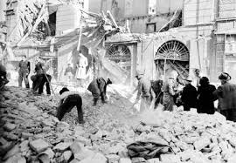
AFTER
Economic recovery was slow, housing was in short supply, and bread was rationed along with many necessities in short supply. It was an "age of austerity". American loans and Marshall Plan grants kept the economy afloat.

